Slide 1
Creating Dashboards with Python
More specifically – plotly & Dash
Summer 2023

Slide 2
Housekeeping
In case of technical problems:
Something wrong on my end (e.g. power outage), I will send you an email.
Something wrong on your end, please send me a text message. 508-769-6446
jcodygroup@gmail.com
We have 4 hours for each session
I will try to give you an opportunity to stand and stretch every hour.
We will take at least one 15-minute break near the halfway point.

Slide 3
About me
Experience:
25+ years consulting and training experience
Extensive work with “big data” and analytics
15 years working with various data visualization tools
Education
Ed. M., Technology, Innovation & Education, Harvard University
PhD Candidate, Education Policy, University of Massachusetts, Amherst

Slide 4
A dashboard created with Python and Dash
https://live-volcano-map-dash-app.onrender.com/

Slide 5
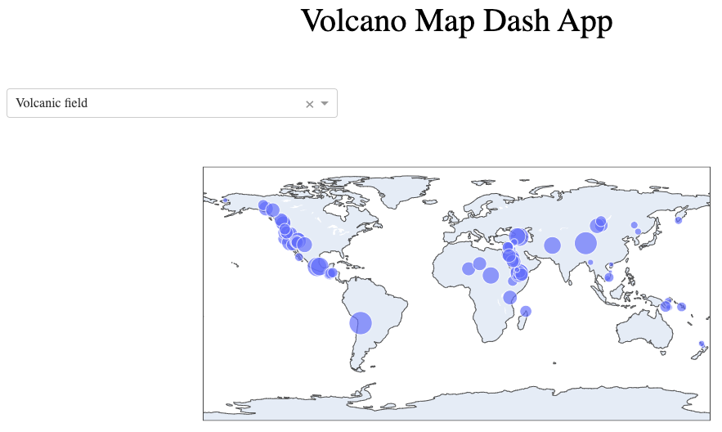
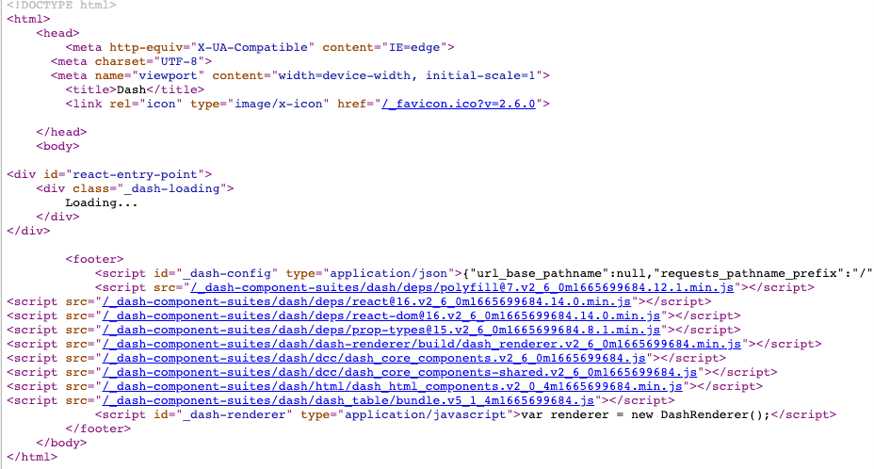
Web Pages: HTML tags, CSS & javascript

Slide 6
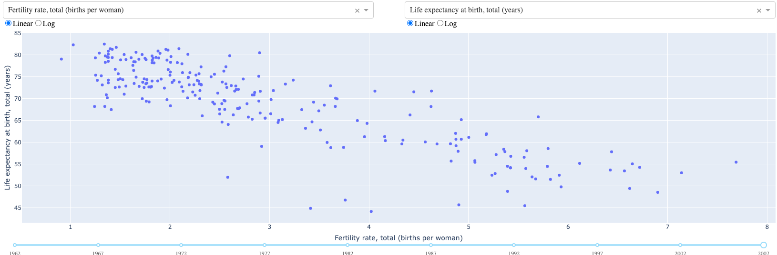
Creating a web-based application
Dashboard Options
Dash
Voila
Streamlit
Bokeh
Panel
Dashboard package
Visualization package
Create
javascript

Slide 7
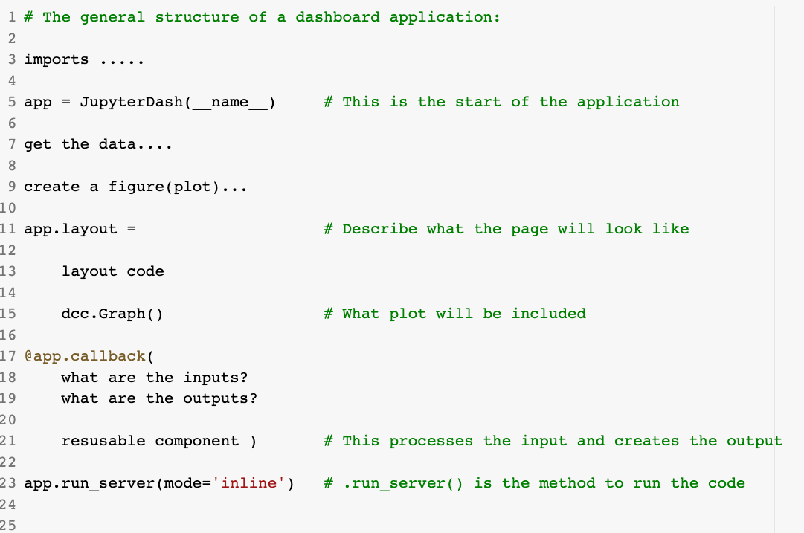
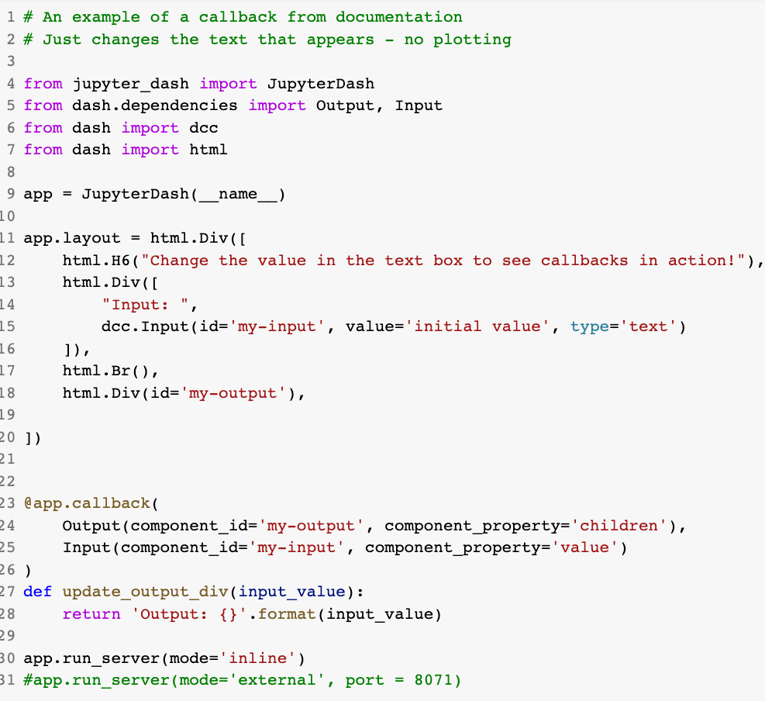
Dash App Structure

Slide 8

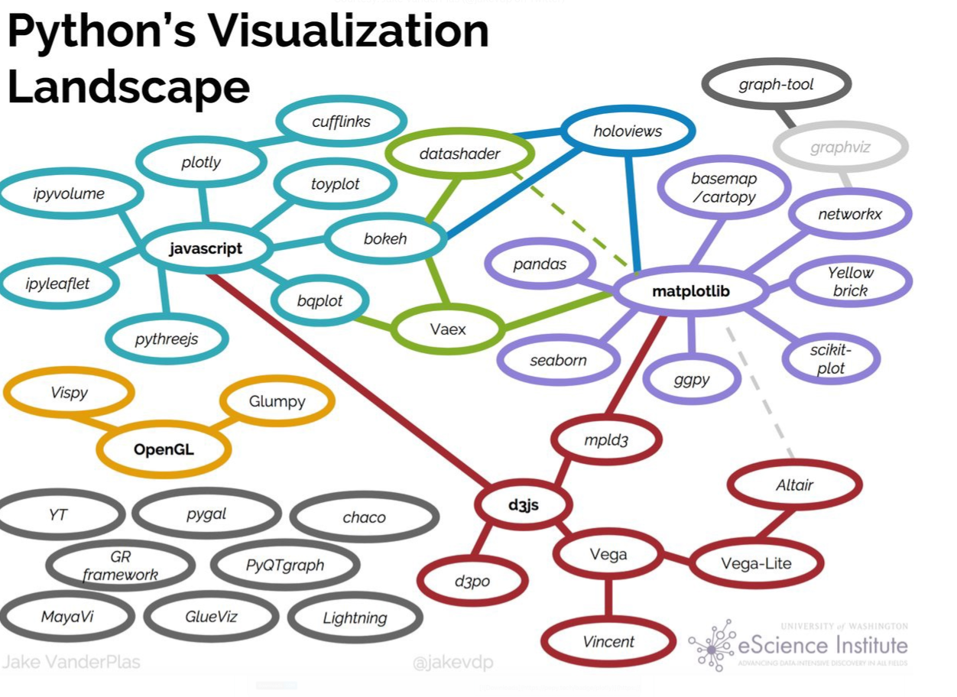




Slide 9
Visualization packages
Matplotlib
pyplot
seaborn
Plotly
express
Dashboard Options
Dash
Voila
Streamlit
Bokeh
Panel
quick &
easy
Matplotlib
Object-oriented
ggplot
Plotly
graph objects
Complex
& many
options
Altair
Built for interactivity

Slide 10
Our tasks
Plotly
Dash
Deploy to Web
Python
(notebooks
ipywidgets)
git
heroku
and through
kaggle

Slide 11
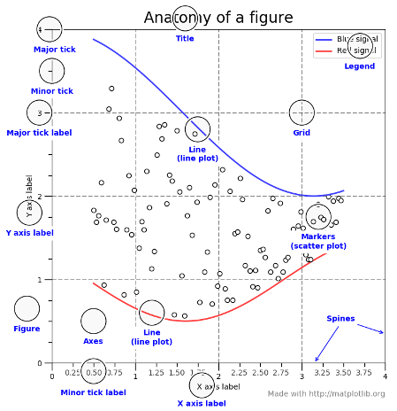
Anatomy of a figure
Matplotlib
pyplot
seaborn
quick &
easy
Matplotlib
Object-oriented
Complex
& many
options

Slide 12
Matplotlib/Seaborn: Two big concepts
Figure
Axes
Plot
Figure
Axes
Plot 1
Plot 2
Figure
Axes
Axes
Plot 1
Plot
Plot 2

Slide 13
Built for interactivity
Matplotlib
pyplot
seaborn
Plotly
express
Dashboard Options
Dash
Voila
Streamlit
Bokeh
Panel
quick &
easy
Matplotlib
Object-oriented
ggplot
Plotly
graph objects
Complex
& many
options
Altair
Built for interactivity

Slide 14
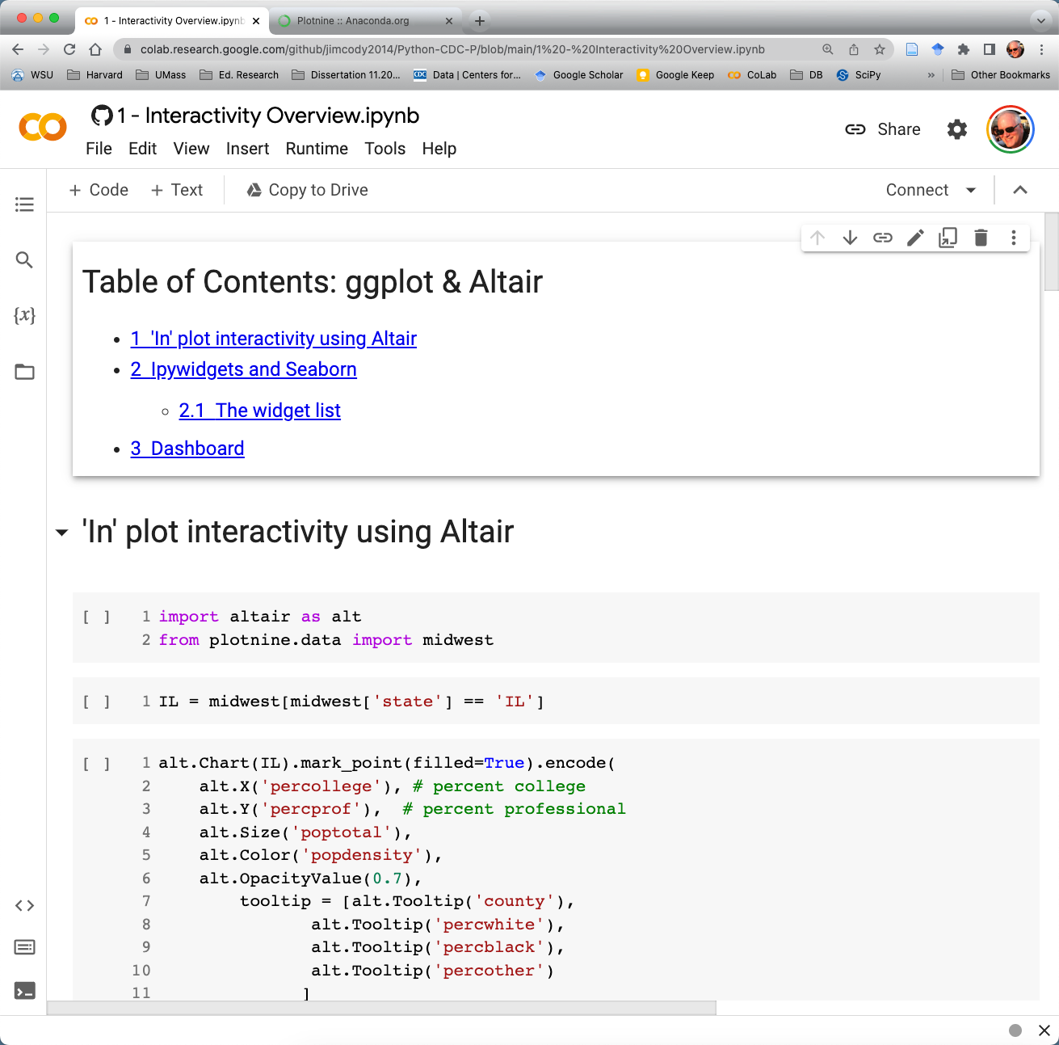
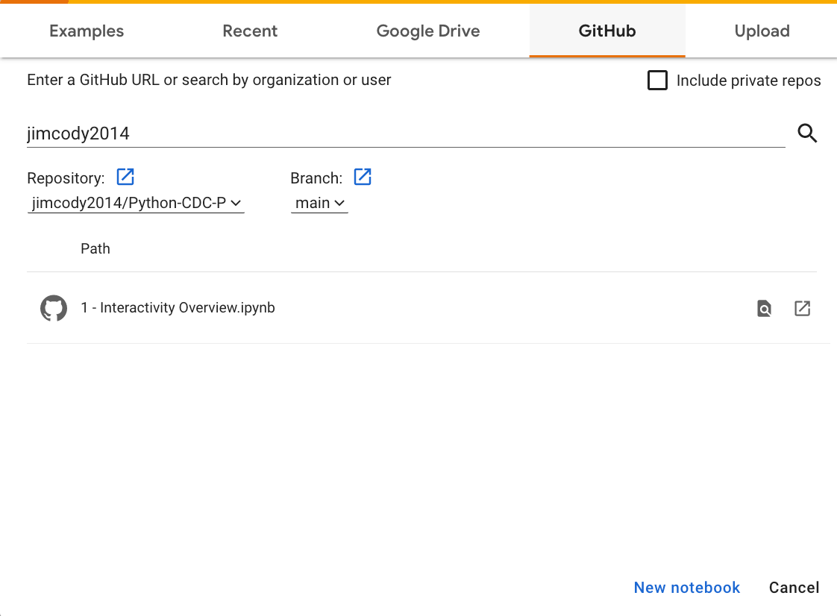
Interactivity notebook
Click there

Slide 15
Creating a web-based application
Dashboard Options
Dash
Voila
Streamlit
Bokeh
Panel
Dashboard package
Visualization package
Create
javascript

Slide 16
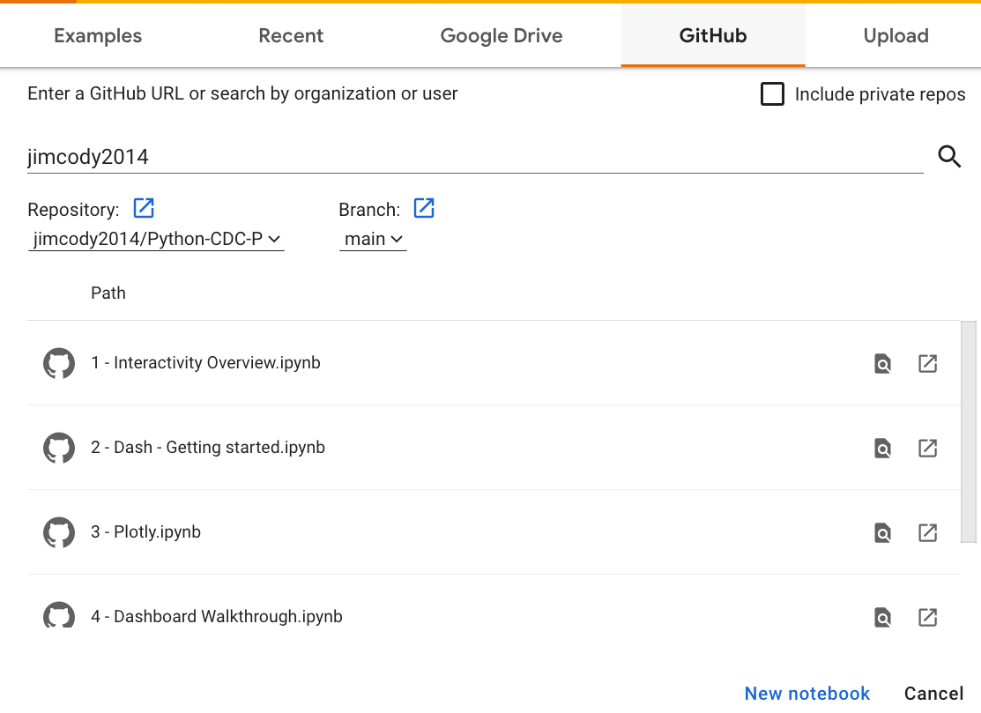
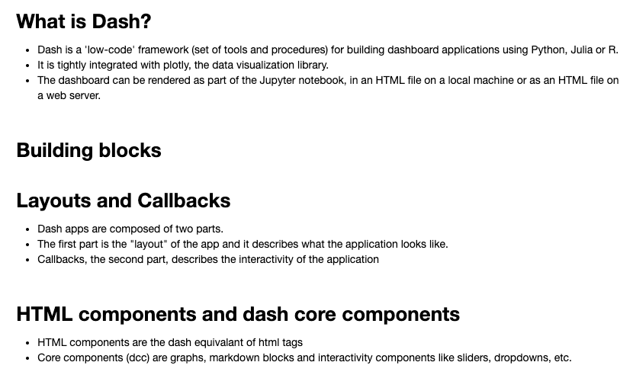
Notebook: 2 – Dash – Getting started
Click there

Slide 17
Our tasks
Dash
Introduction
Plotly express
Plotly
graph objects
Dash exploration
Dash
again
Deploy to Web
Terminology
Structure
CoLab
px.line
px.scatter
px.bar
facets
Figures
Layout
Traces
Data
Update layout
Hover text
Layout
Add a plot
Change plot
Html components
Component args.
Div()
Positioning
Repositioning
Markdown text
Interactivity comps
Callback
Reusable comp
Simple callback
Changing variables
Terminology
Structure
git & heroku

Slide 18
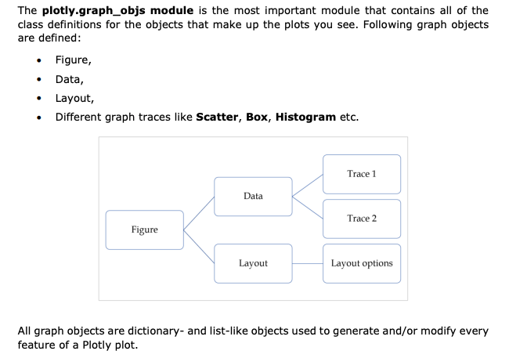
plotly graph objects

Slide 19
Dash Basics
Layout & Callback
Layout: how the page will look
Callbacks: How to make the page interactive
Html components
There is a ‘Dash’ component for every html tag
Core components
Configurable options to ‘do things’ (e.g., make a dropdown list, place a chart, add an input text box, etc.)

